Slide 1
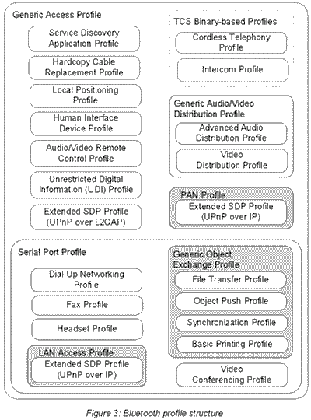
Bluetooth Cheat Sheet v1.0 – 2015 – Steven Vo
Definitions
A wireless technology with open specification for a low-cost, low-power, short range radio technology with 2 main priorities: cheap, and low energy.
- Invented by Ericsson in 1994, the Bluetooth SIG was founded in 1998 with 4 members: IBM, Intel, Nokia, Toshiba. Today has more than 2000 members.
- Usage: PAN, ad-hoc networks, data/voice comms, wireless telematics
- Operates at 2.4Ghz ISM Band, frequency hopping in spectrum [2.402 – 2.480] GHz
- Profiles: are additional protocols that defines what kind of data a Bluetooth module is transmitting. While Bluetooth specifications define how the technology works, profiles define how it’s used.
- Qualifications: interoperability, no license, no LOS, auto ad-hoc network.
Versions
v2.1 2007 | + Enhanced Data Rate, basic pairing (button press, numerical pair), speed up to 3Mps
v3.0 2009 | + High Speed, uses 802.11 (a,b,g,n) to send data, speed up to 24 Mbps.
v4.0 2010 | + Low Energy, speed more than 24 Mbps.
v4.1 2013 | eliminates the interference of Bluetooth radio with 4G automatically, improves data transfer and smarter connectivity.
v4.2 2014 | introduces Low Energy data packet length extensions, Low Energy privacy upgrades and Low Energy secure connections.
Power | Distance | Energy
Class 1 | Long range, 100m | 20 dBm / 100mW
Class 2 | Mid range, 10m | 4 dBm / 1-2.5mW
Class 3 | Short range, 0.1-10m | 0 dBm / 1mW
Ad-hoc Networking
Piconet (a, b) | Decentral, 1 master – 7 slaves | Point to point or multipoint
Scatternet (c) | Overlapping of 2 piconets (max 10), different hopping freqs | Peer 2 peer
Connection Process
Inquiry: discover others by discovery process.
Paging: forming connection between 2 devices.
Connection: enters connection state. 3 modes: Active – in transmission or receiving of data, Sniff – power-saving mode, regular sleep-wake at every X ms, Hold – instructed to sleep by master and wake up after certain interval, Park – deepest sleep mode, until Master tells to wake up.
Layers & their roles
Bluetooth Radio | Lowest defined layer
Baseband | Physical layer, controls: error, flow, hopping (79 channels), security. Has 3 connection modes: - STANDBY, ACTIVE and Power Saving Mode
Audio | 2 codecs: PCM & CVSD, both at 64kbps, using SCO links.
LMP (Link Manager Protocol) | authentication, link setup, acts as service provider, comm with LM PDUs
HCI (Host Controller Interface) | command interface, hardware status, can be via UART, RS232, or USB
L2CAP (Logical Link Control and Adaptation Protocol) | Establish connection (less/full) to upper layer. 2 links types are used: SCO (not supported by L2CAP), ACL (Async conn less)
RFCOMM (Radio Frequency Communication) | Emulation of serial ports, up to 60 simulaneous conns.
SDP (Service Discovery Protocol) | For discovery of services and their characteristics using request/response of one PDU each time.
Protocol Stack
Bluetooth Profile Structure
A2DP | Advanced Audio Distribution Profile Defines the streaming of high quality audio signal between devices (one way).
AVRCP | Audio/Video Remote Control Profile Defines the standard for remote control of TVs, Hifi, etc.
BIP | Basic Imaging Profile For sending (pull/push) images between devices with ability to resize, convert images.
BPP | Basic Printing Profile
DID | Device ID Profile Identifies device, manufacturer, product version, etc.
DUN | Dialup Networking Profile
Bluetooth Classic v/s Bluetooth 4.0 LE
IEEE Standard | 802.15.1 | 802.15.1
Frequency (GHz) | 2.4 | 2.4
Maximum raw bit rate (Mbps) | 1-3 | 1
Typical data throughput (Mbps) | 0.7-2.1 | 0.27
Maximum Range (Meters) | 10 (class 2), 100 (class 1) | 50
Relative Power Consumption | Medium | Very low
Example Battery Life | Days | Months to years
Network Size | 7 | Undefined
FTP | File Transfer Profile
GAVDP | General Audio/Video Distribution Profile – basis for A2DP and VDP.
GEOP | Generic Object Exchange Profile – based on OBEX
HFP | Hands-Free Profile – uses SCO to carry mono voice audio data.
HID | Human Interface Device Profile – input devices such as mouse, joysticks, keyboards, etc.
PAN | Personal Area Networking Profile
SDAP | Service Discovery Application profile

Slide 2
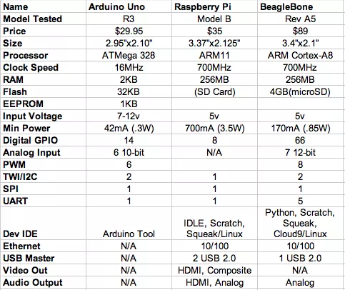
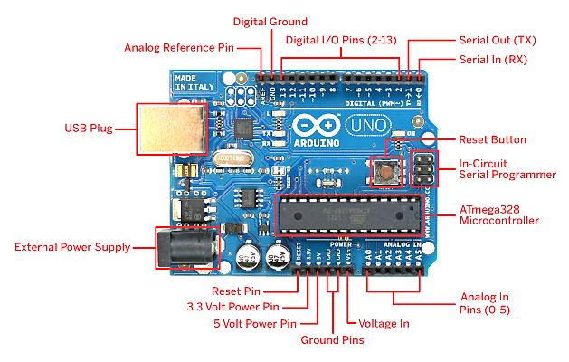
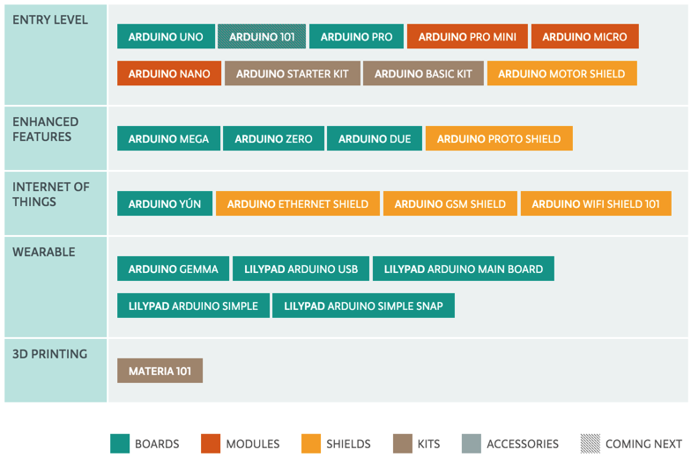
IoT Hardware Cheat Sheet v1.0 – 2015 – Steven Vo
Arduino
Open-source hardware prototyping platform, powered by Arduino programming language (based on Wiring, o/s framework for microcontrollers) and Arduino IDE (based on Processing).
- Simple microcontroller, usually Atmel chip such as ATmega328, 8-6-32 Mhz.
- Programmed in C (i.e. sketches) in Arduino IDE, runs in loop (as embedded software)
- Operating at 3.3V or 5V, input voltage 6-20V
- Has digital pins (1/0), which can be used for both input and output. Some special pins such as PWM can vary the amount of time that it’s ON/OFF really fast so it can simulate an analog output signal.
- Has analog pins, which are mostly used for input, with a built-in A/D converter.
- Flash memory size 32KB, 64KB. ~0.5KB used by the bootloader.
- SRAM size 2KB, 4KB, 8KB depending on the processor.
Choosing IOT Hardware Device
Base on: Form Factor, Shape, Function, Dev/Design, Cost, and Manufacturability.
RFC 7228 defines 3 classes of device depending on RAM and flash memory size:
Class 0 | << 10 KiB | << 100 KiB
Class 1 | ~ 10 KiB | ~ 100 KiB
Class 2 | ~ 50 KiB | ~ 250 KiB
Famous microcontroller manufacturers: MicroChip, Atmel, Intel, Analog devices, etc.
Arduino UNO vs Raspberry Pi vs BeagleBone
IoT General HW Bus/Port Types
I2C | Easiest and most expandable bus, easy for programming.
SPI | Serial Peripheral Interface Limited number of devices, but fast, more difficult to programming
UART | RS-232, old I/O conn
GPIO | Good for turning on/off IO ports.
Arduino UNO Board Layout
Raspberry Pi
A credit card–sized single-board computers developed in the UK RPi Foundation to promote teaching of basic computer science in schools and developing countries.
- ARM-based processor, 700 MHz single-core ARM1176JZF-S (model A, A+, B, B+, CM), 900 MHz quad-core ARM Cortex-A7 (RPi 2)
- Linux/Unix Operating system, e.g. Raspbian, RISC OS, FreeBSD, NetBSD, Plan 9, Inferno, AROS
- 256 MB RAM (model A, A+, B rev 1), 512 MB (model B rev 2, B+, CM), 1 GB RAM (RPi 2)
- Storage uses SDHC slot (model A and B), Micro SDHC slot (model A+ and B+)
- Powerful Broadcom Video Core IV graphic card
- Power:1.5 W (model A), 1.0W (model A+), 3.5W (model B) or 3.0W (model B+), 4.0W (RPi 2)
- Networking: built-in USB Ethernet adapter (except model A/A+)
- Low-level I/O: GPIO: UART, I²C bus, SPI bus with two chip selects, I²S audio +3.3 V, +5 V, ground.
Arduino Devices Roadmap

